Slide 1

Bank Customer Churn Prediction with Machine Learning
- Gang Wei

Slide 2
The $10 Million Question
Can we identify high-risk customers *before* they leave?
Customer churn is a costly problem. Proactive retention is 5x cheaper than new acquisition. Our goal: Build a model to predict the 'Exited' (churn) variable.

Slide 3





Understanding the Customer Profile
Demographics
Account Details
Bank Activity
Key features include Age, Gender, and Geography. These tell us *who* the customer is.
We analyzed Balance, Credit Score, and the Number of Products held by the customer.
Activity signals like Is Active Member, Tenure, and Has Credit Card are critical indicators.

Slide 4
Our 4-Step Analytical Process
2. Compare
4. Select
Trained 6 models (LR, KNN, SVM, RF, Naive Bayes, AdaBoost).
Chose the best model based on F1-Score & ROC AUC performance.
1. Preprocess
3. Tune
Cleaned & scaled data. Handled class imbalance
Used GridSearchCV to find the optimal hyperparameters for each model.

Slide 5
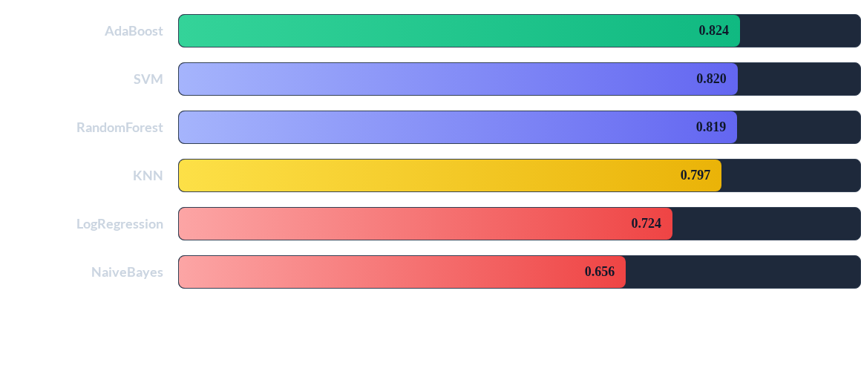
Model Performance (ROC AUC)
Ensemble methods (AdaBoost) and SVM clearly outperformed simpler models, showing the strongest ability to discriminate between churners and non-churners.

Slide 6

And the Winner Is...
AdaBoost
The AdaBoost classifier provided the best balance of performance and reliability, achieving the highest F1-Score (0.74) and ROC AUC (0.824) on the test data.

Slide 7
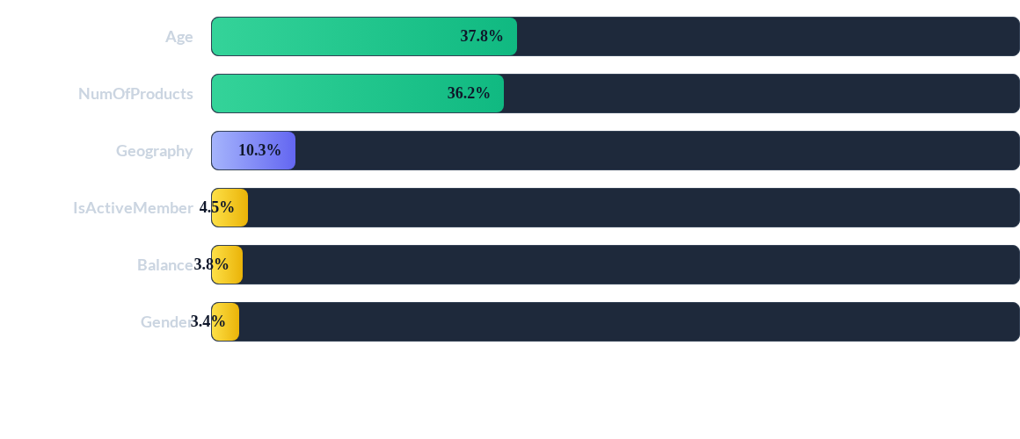
Key Drivers of Churn (Feature Importance)
A customer's Age and their Number of Products are overwhelmingly the most important predictors, accounting for over 70% of the model's decision-making.

Slide 8
Key Finding #1: Age as a Driver
38%
of Churn predicted by Age
Life Events Drive Churn

Slide 9
Key Finding #2: Product "Stickiness"
Customers with only one product are a major flight risk. The path from 1 to 2 products is the most critical retention checkpoint.
"
"
Age and number of products are the two leading, most powerful predictors. Our retention strategy must be segmented by age and number of products brackets to be effective.

Slide 10
From Model to Action: Recommendations
Targeted Retention: Launch proactive retention campaigns for customers in high-risk age brackets, offering incentives tailored to their life stage.
Cross-Sell Strategy: Aggressively market a 2nd product (e.g., credit card, savings account) to single-product customers. This is the lowest-hanging fruit for increasing "stickiness".
Regional Focus: Investigate *why* churn is higher in specific geographies (like Germany in our dataset) and address underlying regional issues, be it competition or service gaps.

Slide 11


Future Work: Deployment & Refinement
Deployment
Refinement
The next logical step is to move this model from a static notebook into a production API. This would allow the bank to score all customers in real-time and flag high-risk accounts for immediate action.
We can further improve the model by incorporating cost-sensitive learning. The cost of a 'False Negative' (missing a real churner) is much higher than a 'False Positive', and the model should be tuned to reflect this business reality.

Slide 12
Questions?
Thank you for your time.

